Slide 1


TRACKING INTERNET SALES USING ADVENTURE WORKS
Data warehouse implementation
Final Project
Submitted By’
Basavraj Jaliminche (8800149)
RAGHUVEER Reddy (8801135)
Nachiket Solanki (8799955)
Rohit Arora (8786754)

Slide 2
Agenda:
Track the fields in Internet sales database using STAR schema dimension modeling.
In this project we are going to track fields like ,
1.UnitPrice
2.TotalProductCost
3.SalesAmount
4.TaxAmt
5.Freight

Slide 3
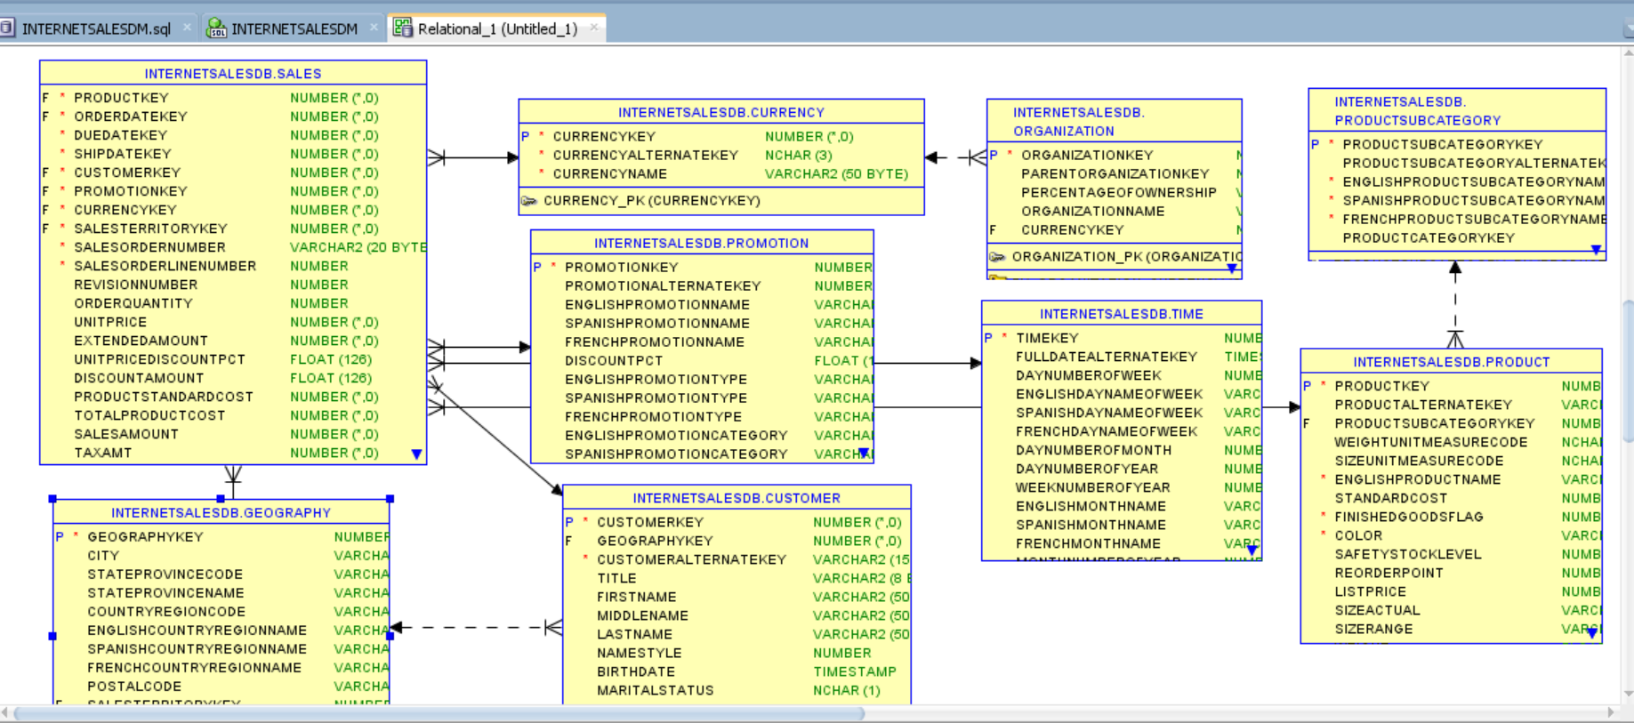
System Relational Model :

Slide 4
Internet Sales Datamart
Designing the STAR schema :
Star schema is the fundamental schema among the data mart schema and it is simplest. This schema is widely used to develop or build a data warehouse and dimensional data marts. It includes one or more fact tables indexing any number of dimensional tables. The star schema is a necessary cause of the snowflake schema. It is also efficient for handling basic queries.
Advantages of Star Schema :
Simpler Queries
Simplified Business Reporting Logic
Feeding Cubes

Slide 5
Slowly Changing Dimension:
A slowly changing dimension (SCD) is a dimension where non-key attributes may change over time.
Three most common types of SCD:
In a Type 0 SCD, records may never change. We may only add new records. Any attempt to change an existing record in our ETL should result in an error
In a Type 1 SCD, non-key attributes are changed by overwriting the original value. This means that all associated fact records will be associated with the new value, regardless of what the value was at the time the fact record was created.
In a Type 2 SCD, non-key attributes are changed by creating a new record. This allows us to preserve a history of the changes. It also allows us to preserve the relationship between facts and the dimension values they were associated with when the fact records were created.

Slide 6
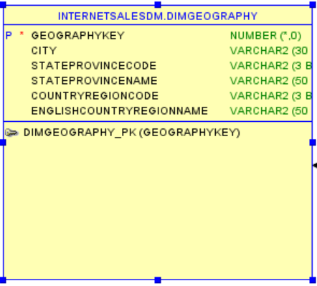
Geography Dimension:
CREATE TABLE DimGeography( GeographyKey int PRIMARY KEY NOT NULL, City varchar2(30) NULL, StateProvinceCode varchar2(3) NULL, StateProvinceName varchar2(50) NULL, CountryRegionCode varchar2(3) NULL, EnglishCountryRegionName varchar2(50) NULL);
By carefully examining above table, we came to conclusion that its a type 1 SCD

Slide 7
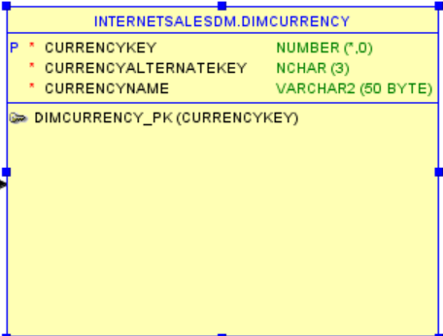
Currency Dimension:
CREATE TABLE DimCurrency( CurrencyKey int PRIMARY KEY NOT NULL, CurrencyAlternateKey nchar(3) NOT NULL, CurrencyName varchar2(50) NOT NULL );
By carefully examining above table, we came to conclusion that its a type 0 SCD.
As currencies of the countries may not change it’s a type 0 SCD

Slide 8
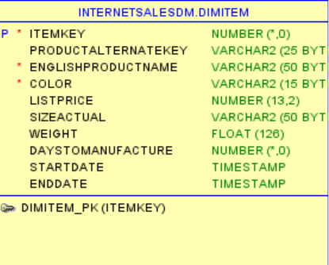
Item Dimension
CREATE TABLE DimItem( ItemKey int PRIMARY KEY NOT NULL, ProductAlternateKey varchar2(25) NULL, EnglishProductName varchar2(50) NOT NULL, Color varchar2(15) NOT NULL, ListPrice decimal(13,2) NULL, SizeActual varchar2(50) NULL, Weight float NULL, DaysToManufacture int NULL, StartDate TIMESTAMP NULL, EndDate TIMESTAMP NULL );
By carefully examining above table, we came to conclusion that its a type 2 SCD.
As new products may be launched and same products may have different types ,it’s a type 2 SCD

Slide 9
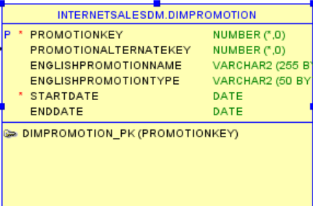
Promotion Dimension
CREATE TABLE DimPromotion( PromotionKey int PRIMARY KEY NOT NULL, PromotionAlternateKey int NULL, EnglishPromotionName varchar2(255) NULL, EnglishPromotionType varchar2(50) NULL, StartDate Date NOT NULL, EndDate Date NULL, );
By carefully examining above table, we came to conclusion that its a type 2 SCD.
As promotions may vary time to time ,it’s a type 2 SCD.

Slide 10
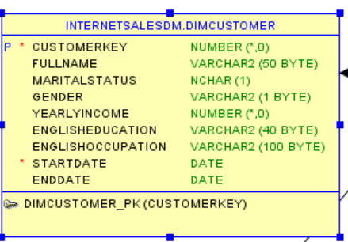
Customer
CREATE TABLE DimCustomer( CustomerKey int PRIMARY KEY NOT NULL, CustomerAlternateKey varchar2(15) NOT NULL, FullName varchar2(50) NULL, MaritalStatus nchar(1) NULL, Gender varchar2(1) NULL, YearlyIncome numeric NULL, EnglishEducation varchar2(40) NULL, EnglishOccupation varchar2(100) NULL, tartDate DATE NOT NULL, EndDate DATE NULL );
By carefully examining above table, we came to conclusion that its a type 2 SCD.
As new custamor may be added and customor attributes may change ,it’s a type 2 SCD

Slide 11
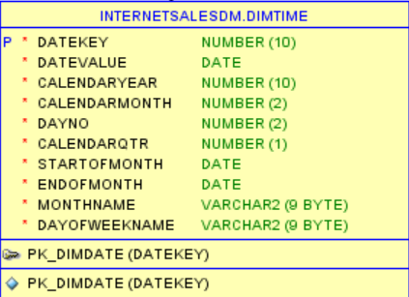
Time Dimension :
CREATE TABLE DimTime (DateKey NUMBER(10) NOT NULL,DateValue DATE NOT NULL,CalendarYear NUMBER(10) NOT NULL,CalendarMonth NUMBER(2) NOT NULL,DayNo NUMBER(2) NOT NULL,CalendarQtr NUMBER(1) NOT NULL,StartOfMonth DATE NOT NULL,EndOfMonth DATE NOT NULL,MonthName VARCHAR2(9) NOT NULL,DayOfWeekName VARCHAR2(9) NOT NULL,CONSTRAINT PK_DimDate PRIMARY KEY ( DateKey ));
By carefully examining above table, we came to conclusion that its a type 0 SCD.

Slide 12
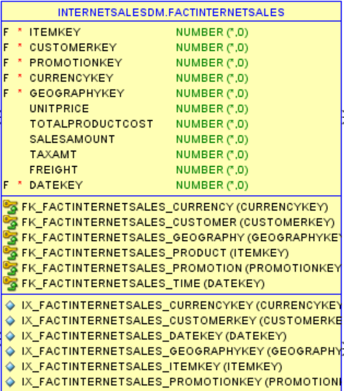
Fact Internet Sales :
CREATE TABLE FactInternetSales( ItemKey int NOT NULL, CustomerKey int NOT NULL, PromotionKey int NOT NULL, CurrencyKey int NOT NULL, GeographyKey int NOT NULL, DateKey NUMBER(10) NOT NULL, UnitPrice numeric NULL, TotalProductCost numeric NULL, SalesAmount numeric NULL, TaxAmt numeric NULL, Freight numeric NULL );
All the primary keys of the dimension tables are added as foreign keys to fact table .

Slide 13
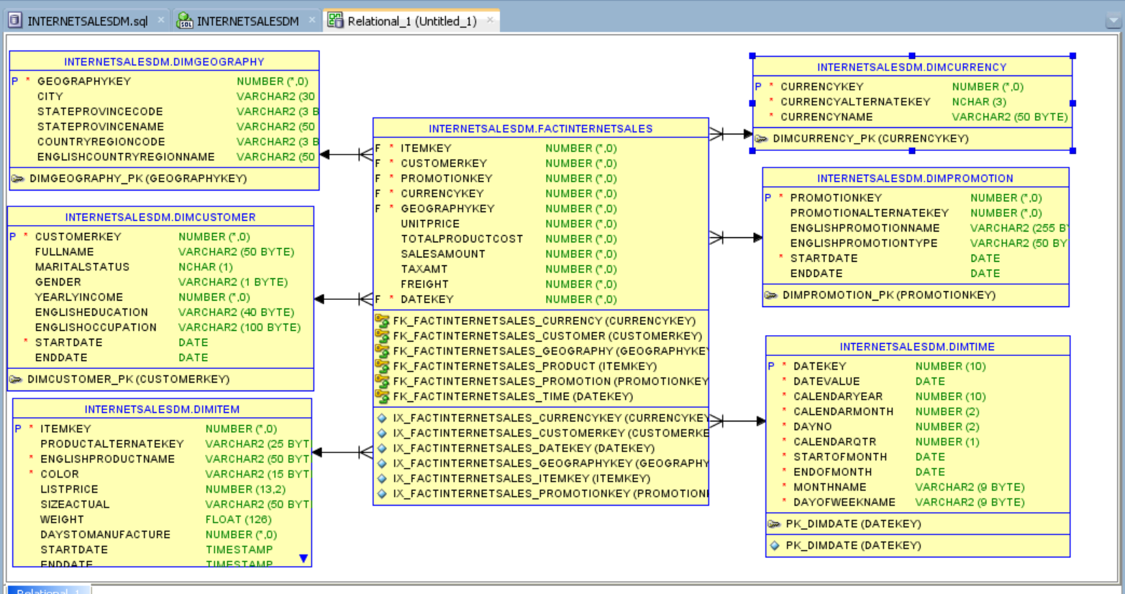
Star Schema ERD Diagram:

Slide 14
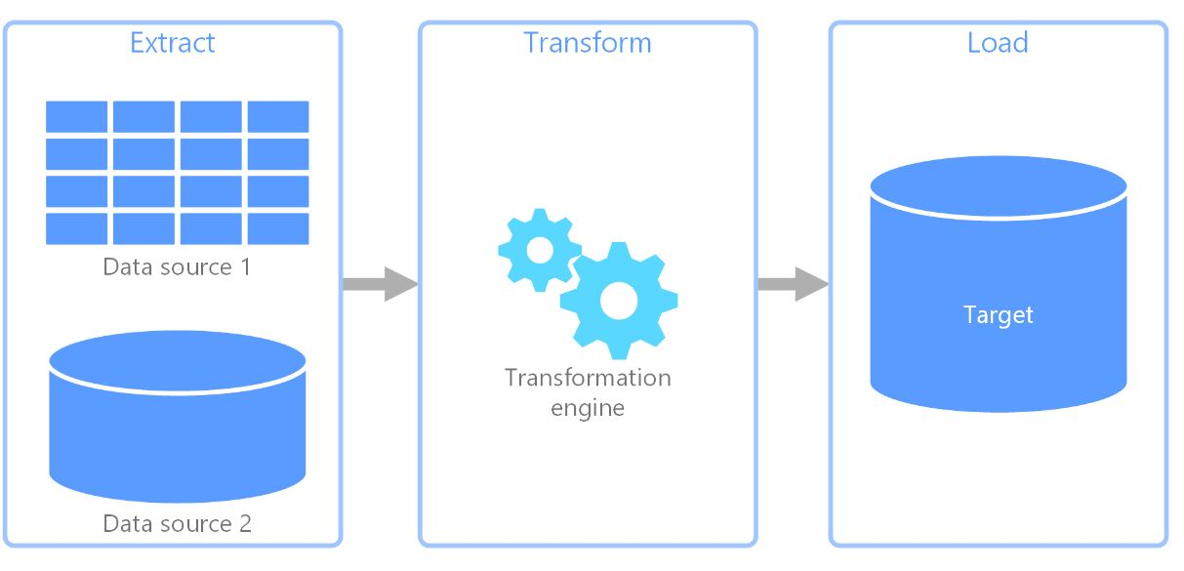
ETL : Extract Transform Load
ETL, which stands for extract, transform, and load, is the process data engineers use to extract data from different sources, transform the data into a usable and trusted resource, and load that data into the systems end-users can access and use downstream to solve business problems.

Slide 15
Steps for ETL:
Extract : The first step of this process is extracting data from the target sources that are usually heterogeneous such as business systems, APIs, sensor data, marketing tools, and transaction databases, and others. As you can see, some of these data types are likely to be the structured outputs of widely used systems, while others are semi-structured JSON server logs.
Transform:The second step consists of transforming the raw data that has been extracted from the sources into a format that can be used by different applications. In this stage, data gets cleansed, mapped and transformed, often to a specific schema, so it meets operational needs. This process entails several types of transformation that ensure the quality and integrity of data Data is not usually loaded directly into the target data source, but instead it is common to have it uploaded into a staging database. This step ensures a quick roll back in case something does not go as planned. During this stage, you have the possibility to generate audit reports for regulatory compliance, or diagnose and repair any data issues.

Slide 16
Load :
the load function is the process of writing converted data from a staging area to a target database, which may or may not have previously existed. Depending on the requirements of the application, this process may be either quite simple or intricate. Each of these steps can be done with ETL tools or custom code.

Slide 17
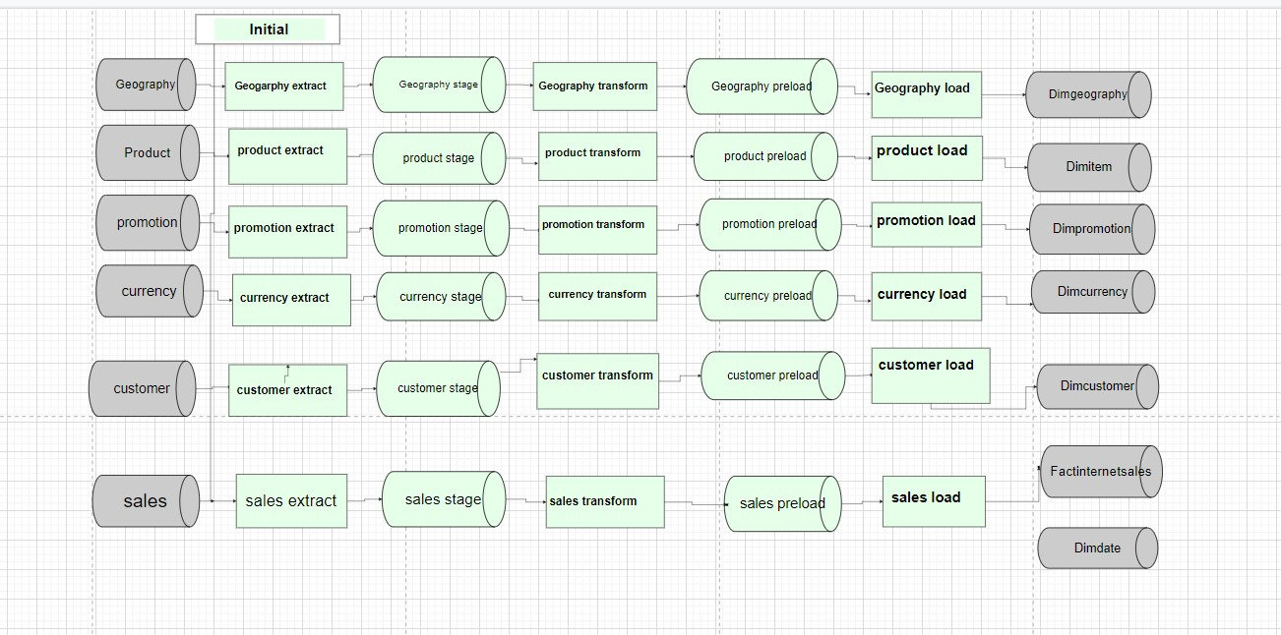
ETL Process Diagram:

Slide 18
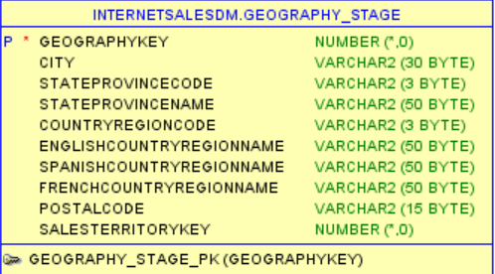
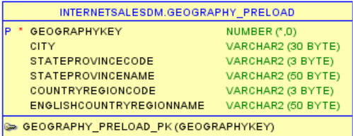
Geography ETL

Slide 19
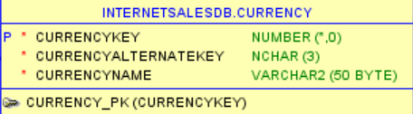
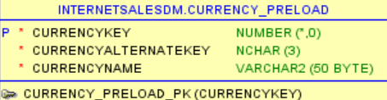
Currency ETL :

Slide 20
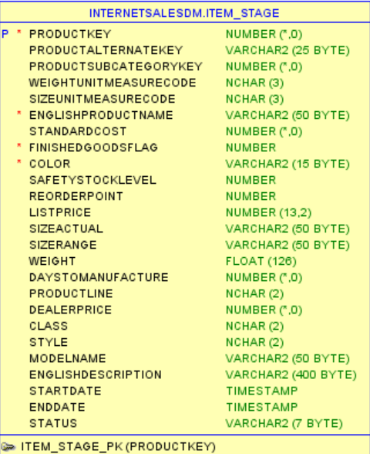
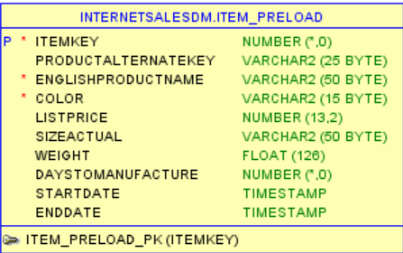
Item ETL

Slide 21
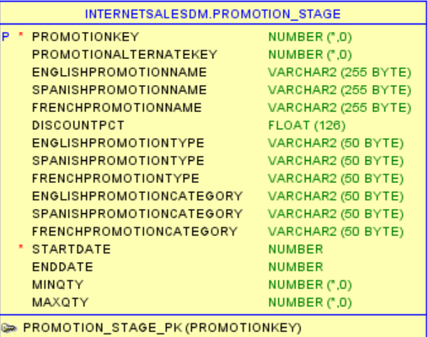
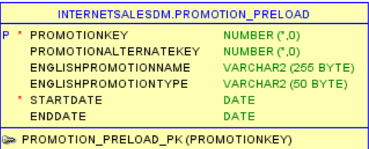
Promotion ETL :

Slide 22
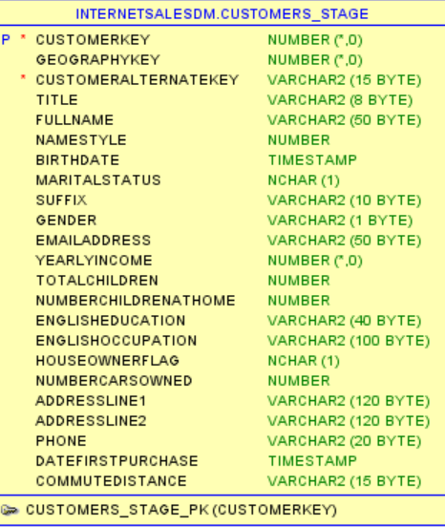
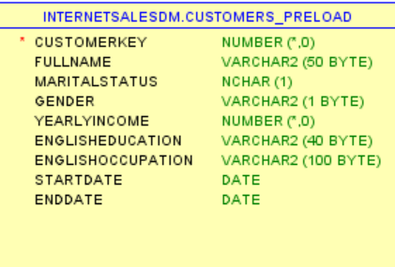
Customer ETL :

Slide 23
Time ETL :
Loaded by procedure DimTimeLoad Based on System Date

Slide 24
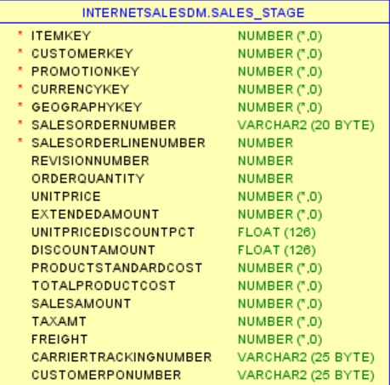
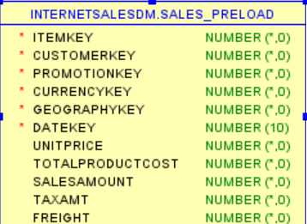
Fact Internet Sales ETL :

Slide 25
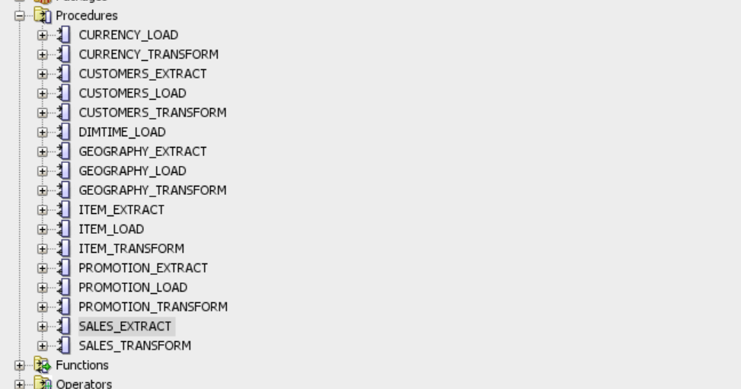
PL/SQL Procedures
Data is transferred between stage ,preload and dimension tables through procedures created in the internet sales DM .

Slide 26
OLAP : Oracle OLAP is a world class multidimensional analytic engine
Oracle OLAP makes it easy to produce analytic measures, including time-series calculations, financial models, forecasts, allocations, regressions, and more.
Hundreds of analytic functions can be easily combined in custom functions to solve nearly any analytic calculation requirement.
Oracle OLAP cubes are represented using a star schema design: dimension views form a constellation around the cube (or fact) view.
This standard representation of OLAP data makes it easy for any reporting and analysis tool or application - including sophisticated business intelligence solutions, SQL-based development tools and Microsoft Excel - to leverage the power of Oracle OLAP in a simple and productive way.

Slide 27
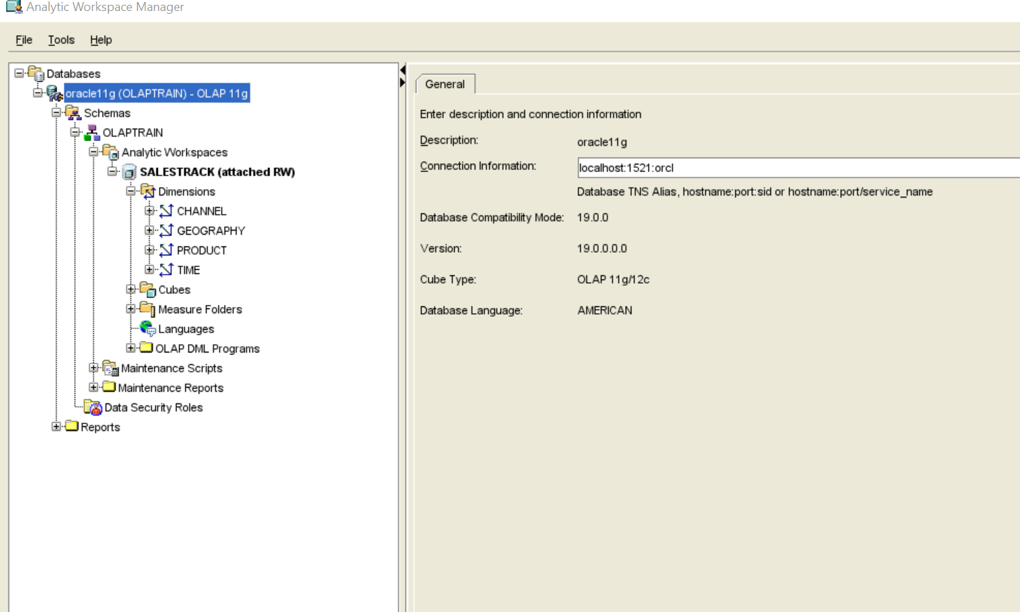
Steps done for OLAP
As mentioned in the document we have done steps

Slide 28
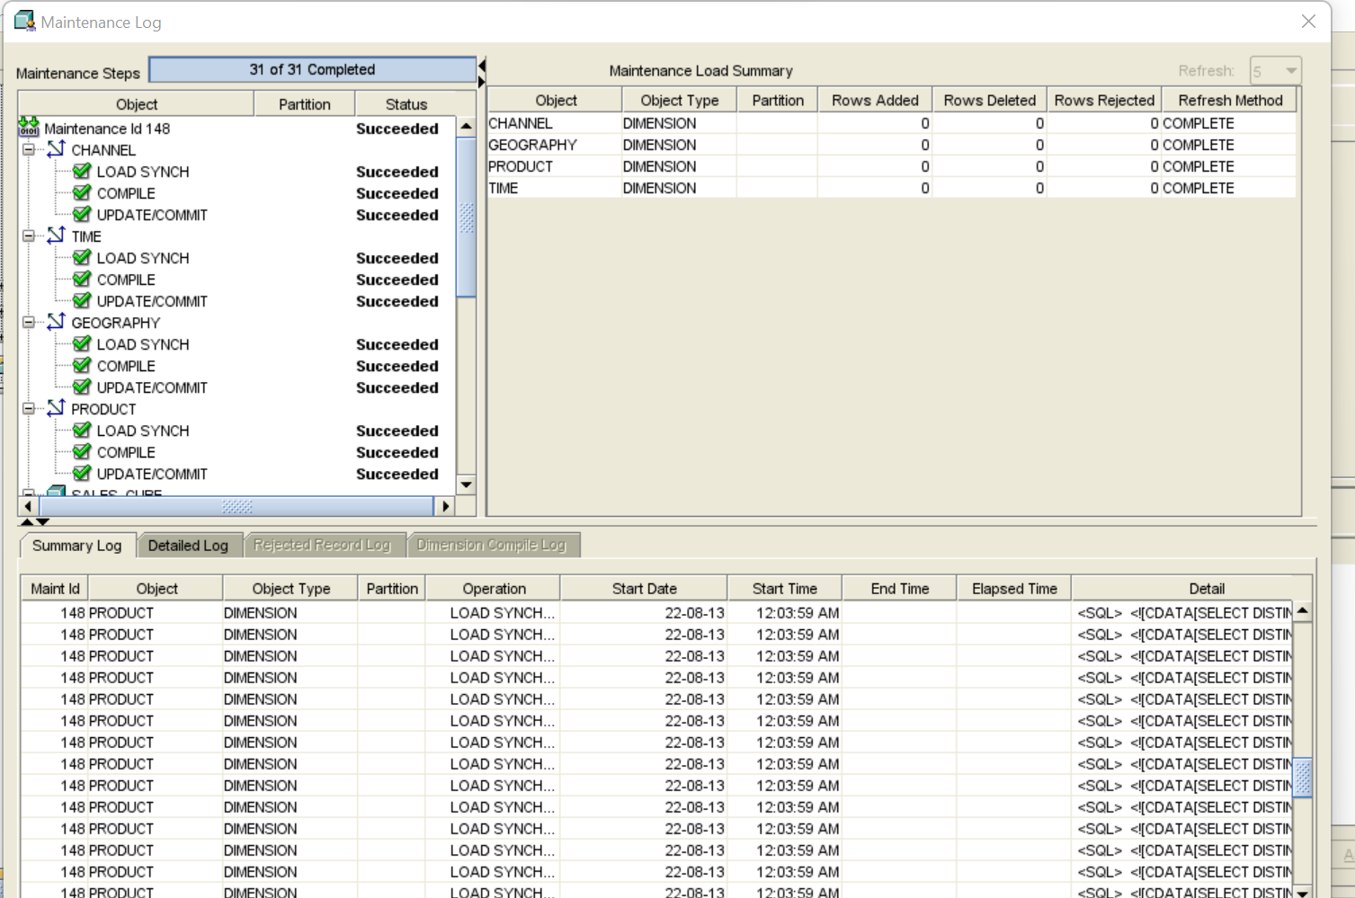
Maintenance Log

Slide 29
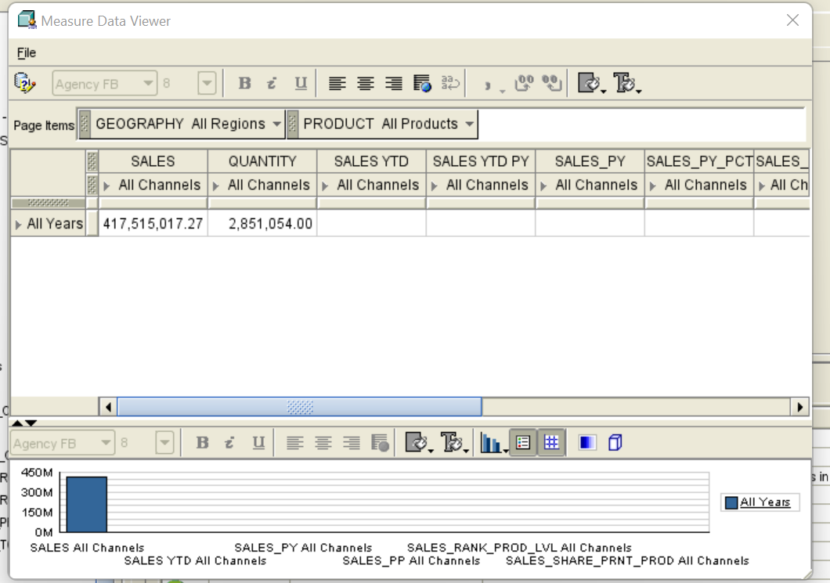
Data for all Years

Slide 30
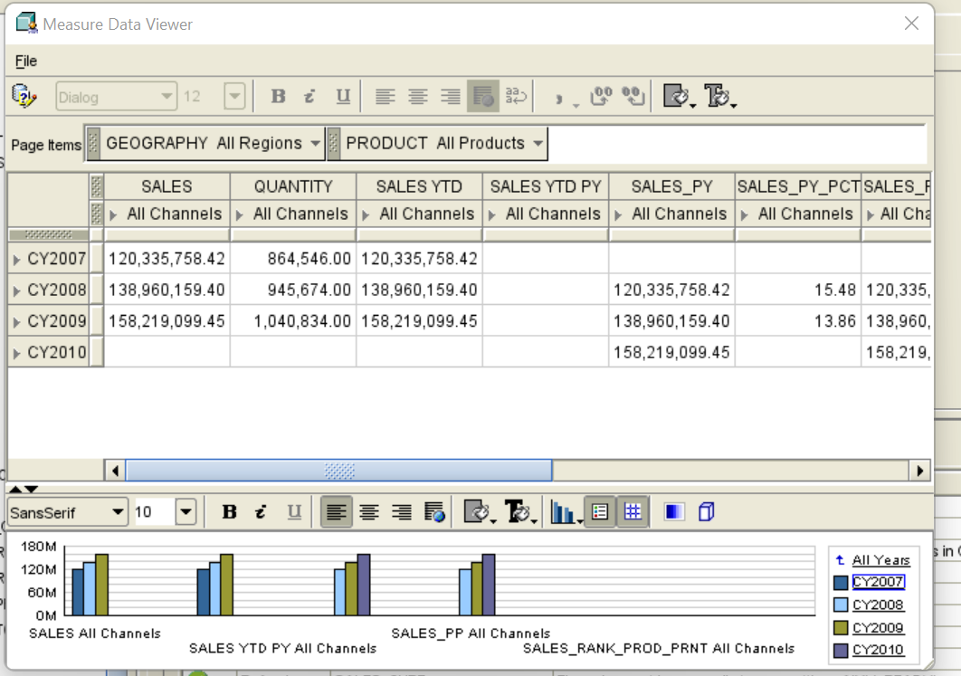
Data with Quatarly sales :

Slide 31
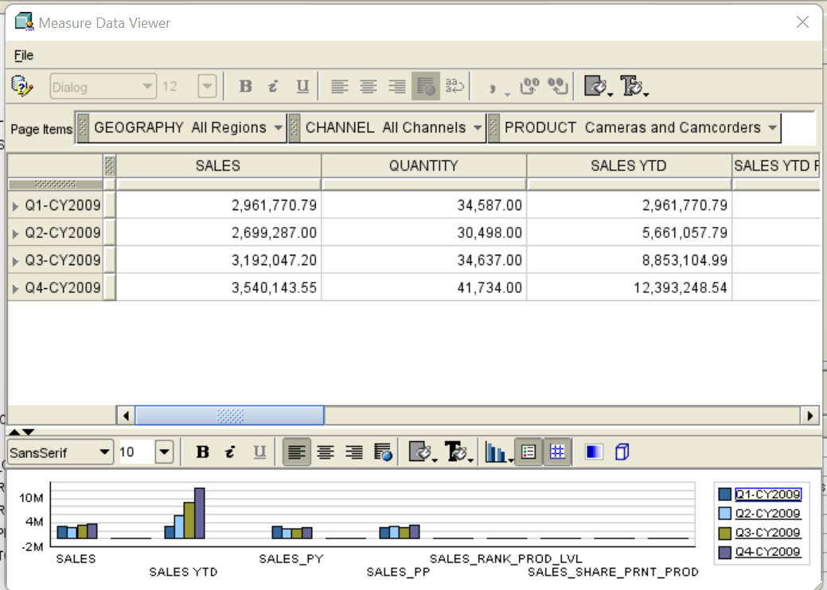

Slide 32
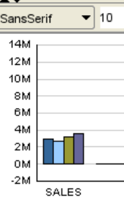
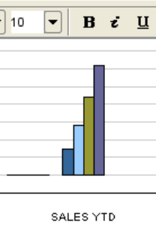
Sales data View :

Slide 33

Thank You!

